Slide 1
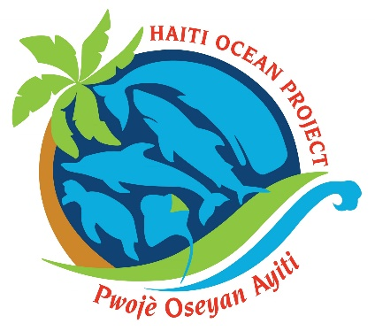
CAMAC - Effectiveness of community-based education and fisher training programs to sensitize local populations in Haiti about whales
[your logo]
Jamie Aquino, Francklin Barbier, Charlens Calixte, Claude Pressoir, Cleeford Joseph, Myson Samedi, Courtney Vail
Haiti Ocean Project

Slide 2
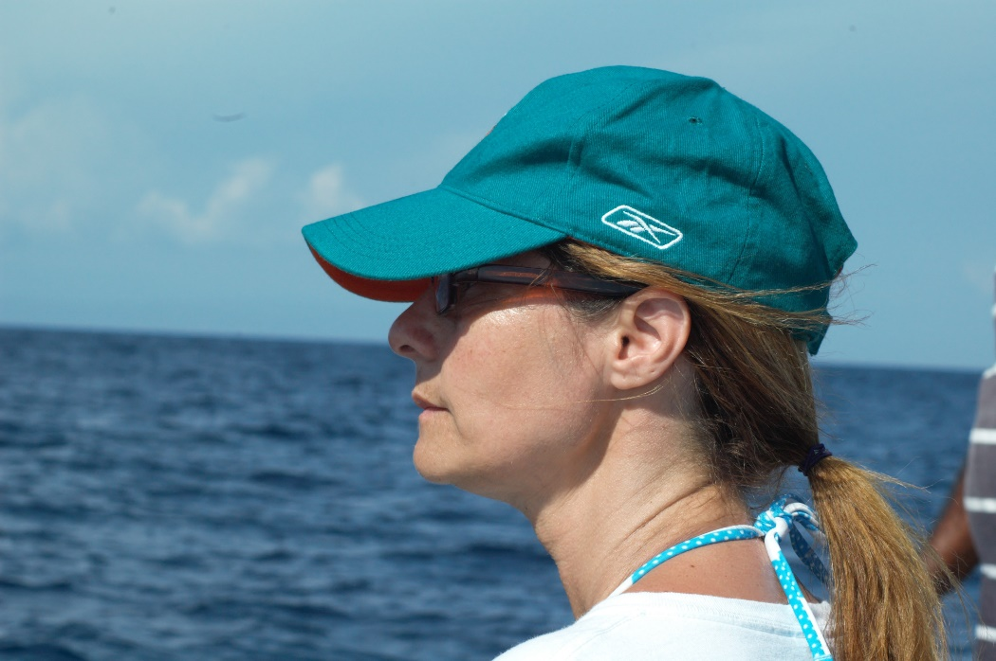
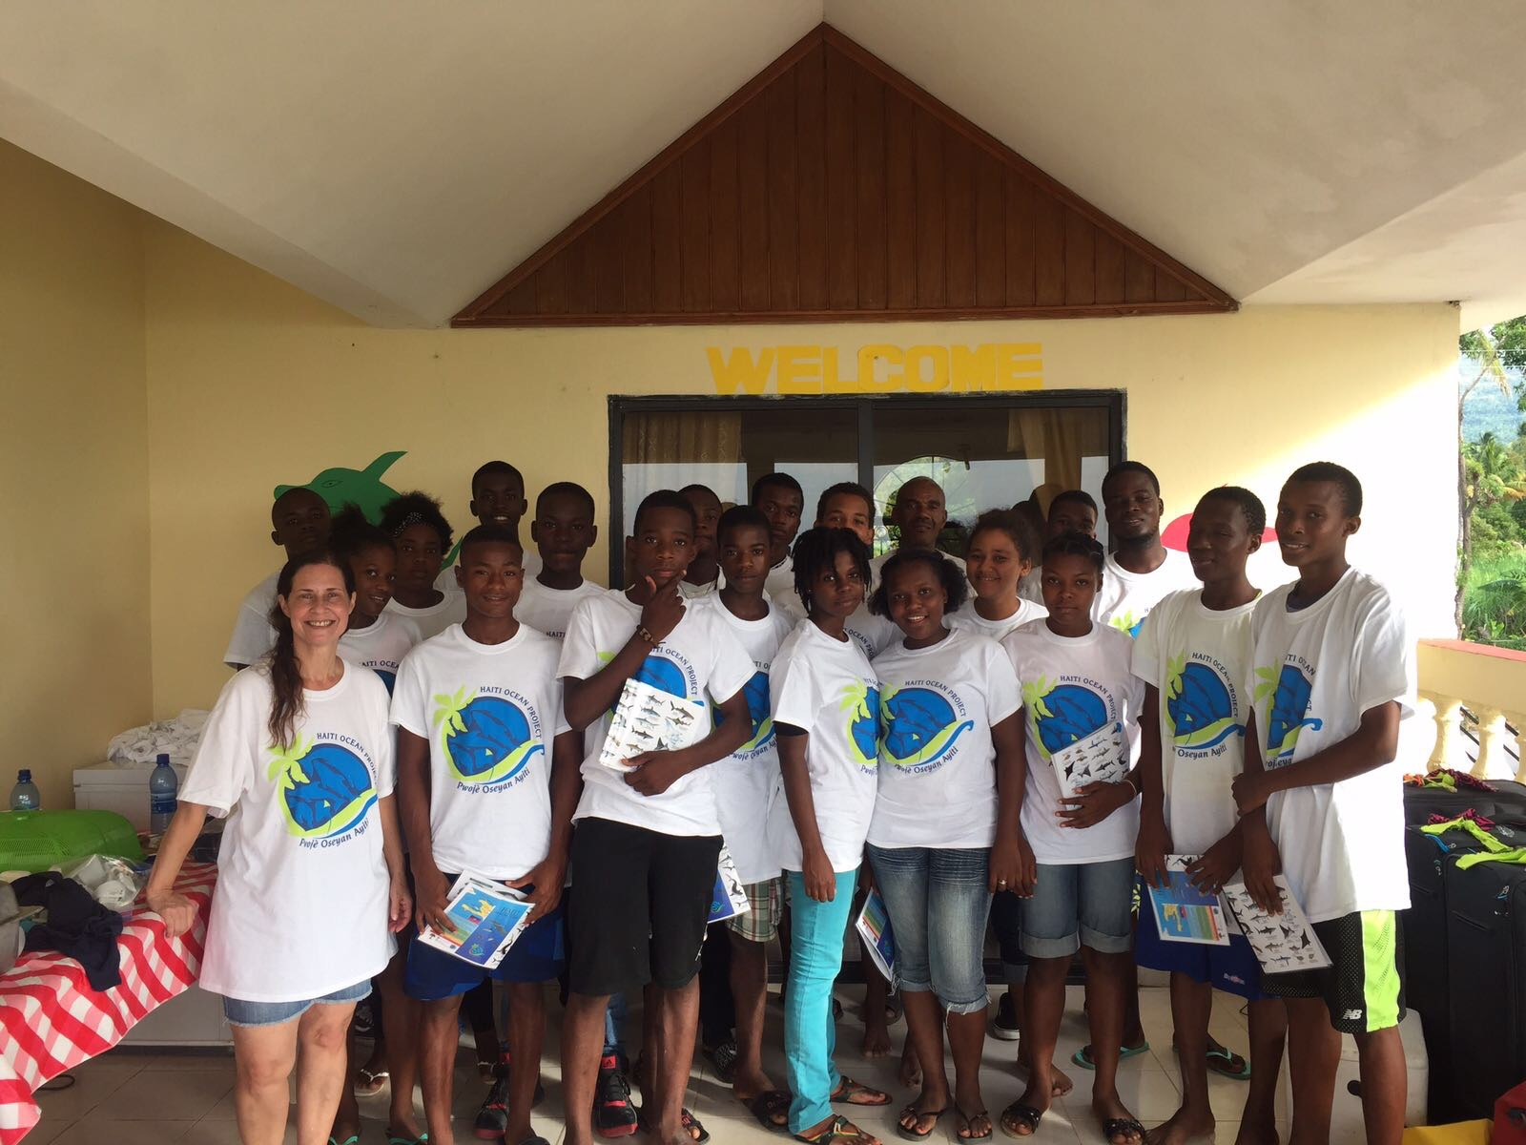
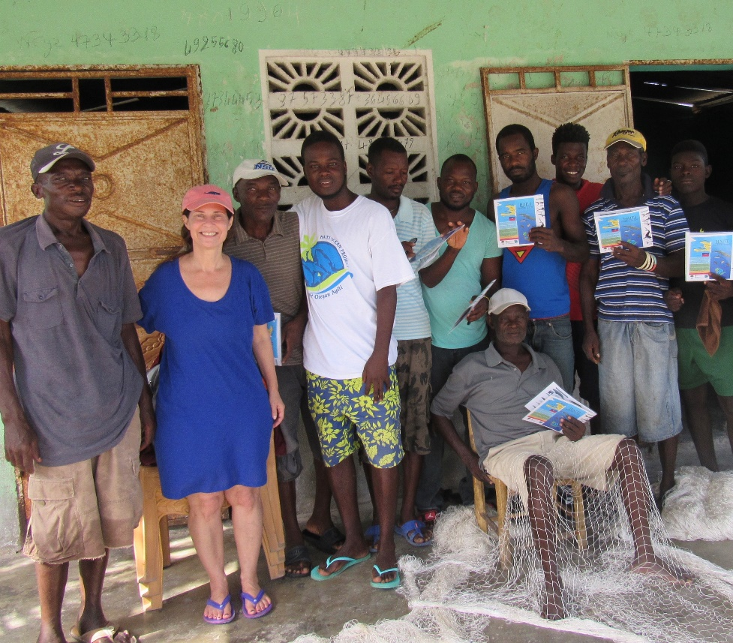
INTRODUCING ME:
Jamie Aquino
President/founder, Haiti Ocean Project

Slide 3
Objectives:
1. Marine education
2.Conservation
3. Research
Involving
marine megafauna:
1. Marine mammals
2. Sea turtles
3. Sharks
4. Stingrays

Slide 4
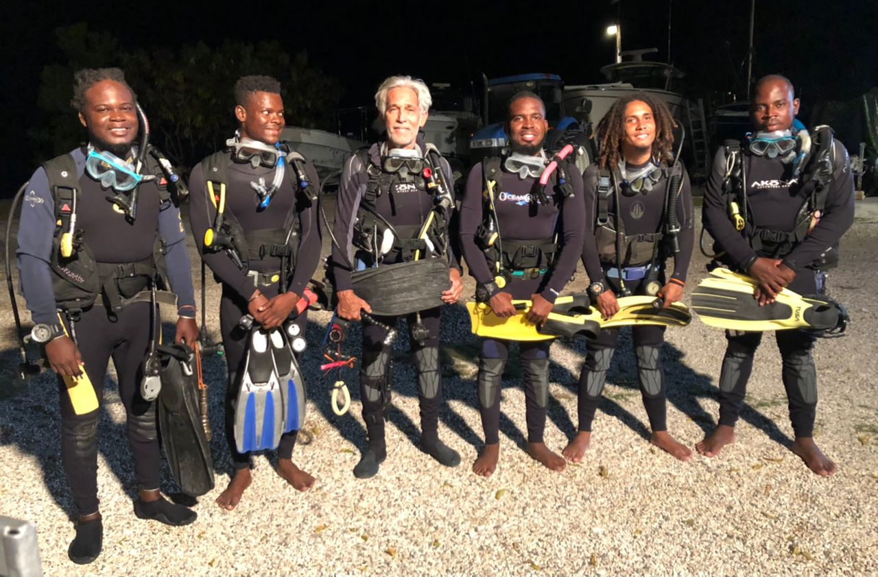
Haiti Ocean Project local coordinators

Slide 5
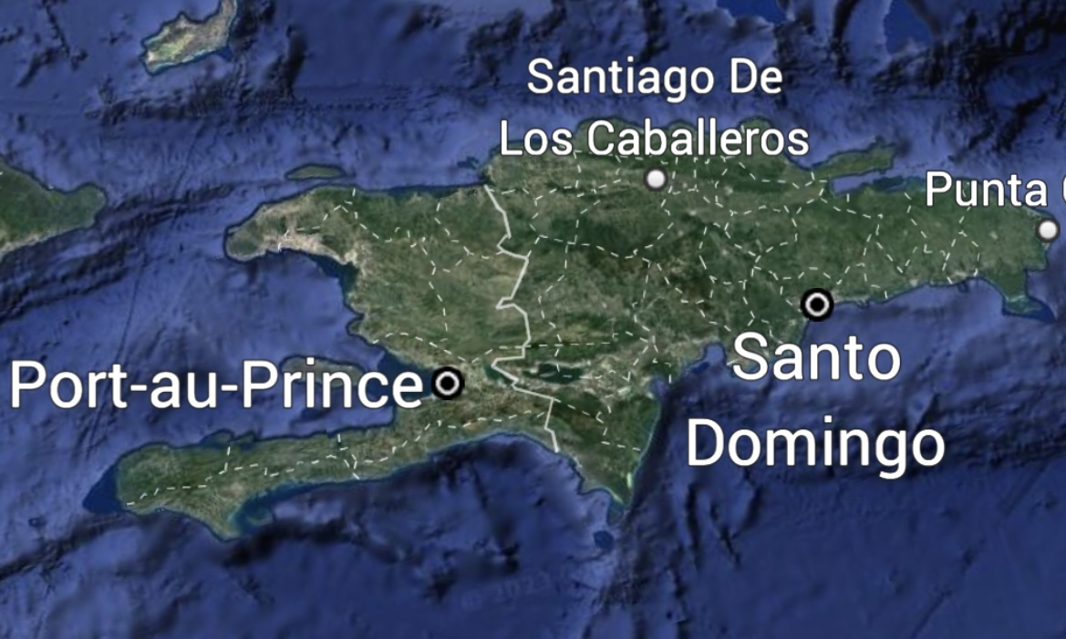
Island of Hispaniola

Slide 6
Confirmed whale species in Haiti
DWARF SPERM WHALE
SPERM WHALE
BEAKED WHALE
HUMPBACK WHALE
MINKE WHALE

Slide 7
Haiti
WHERE ARE THE WHALES?

Slide 8
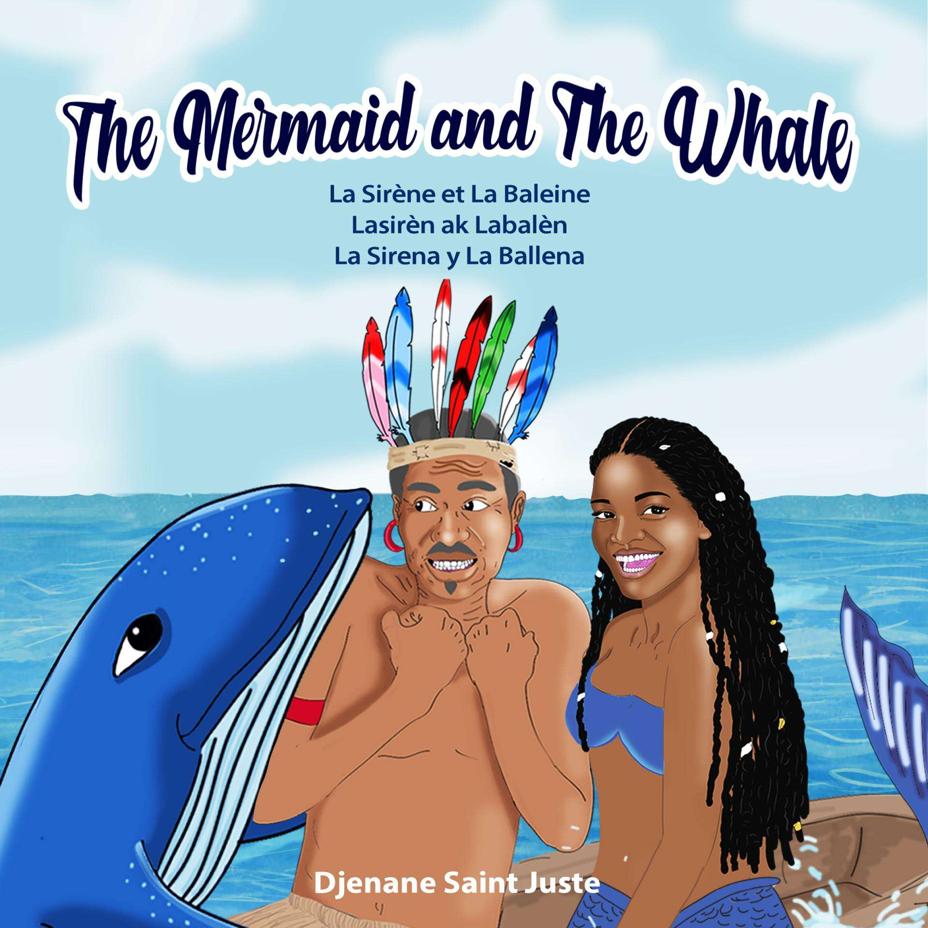
What do local Haitians know about whales?
The Mermaid and The Whale
Lasirèn ak Labalèn
Haitian song passed down through oral tradition
Turned into a book by a Haitian dancer

Slide 9
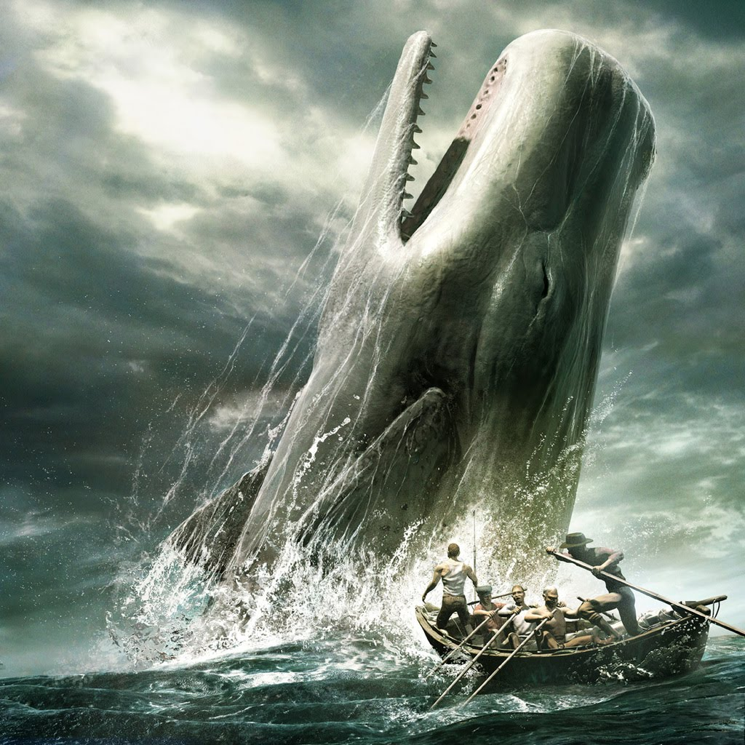
How do local Haitians perceive whales?
Haiti fishers fear of whales
The bigger whales primarily because of their size. The smaller whales can scare the fishers if they have never seen the species before.

Slide 10
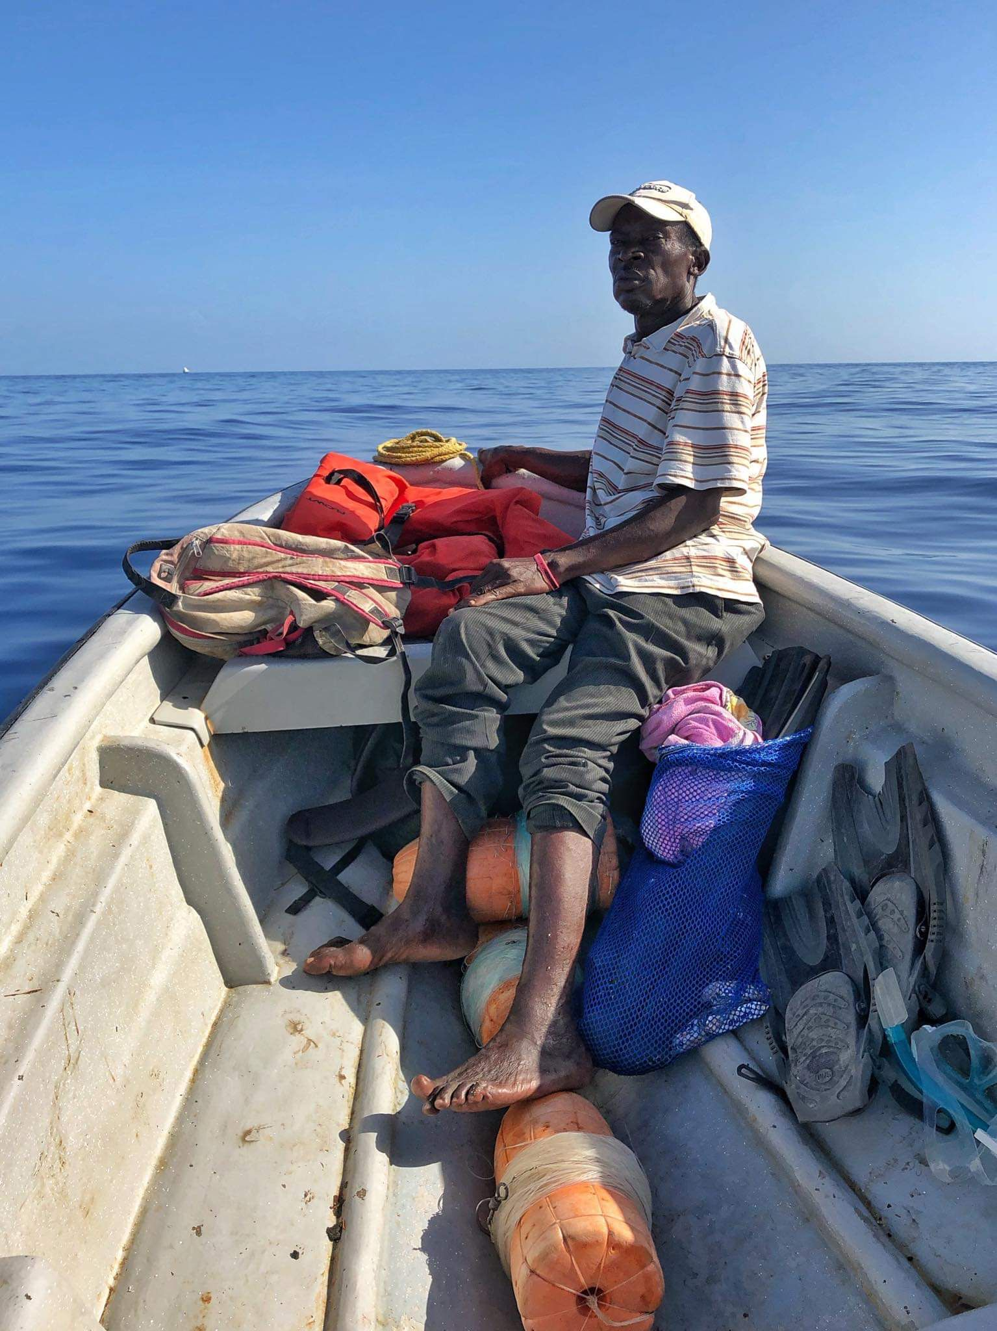
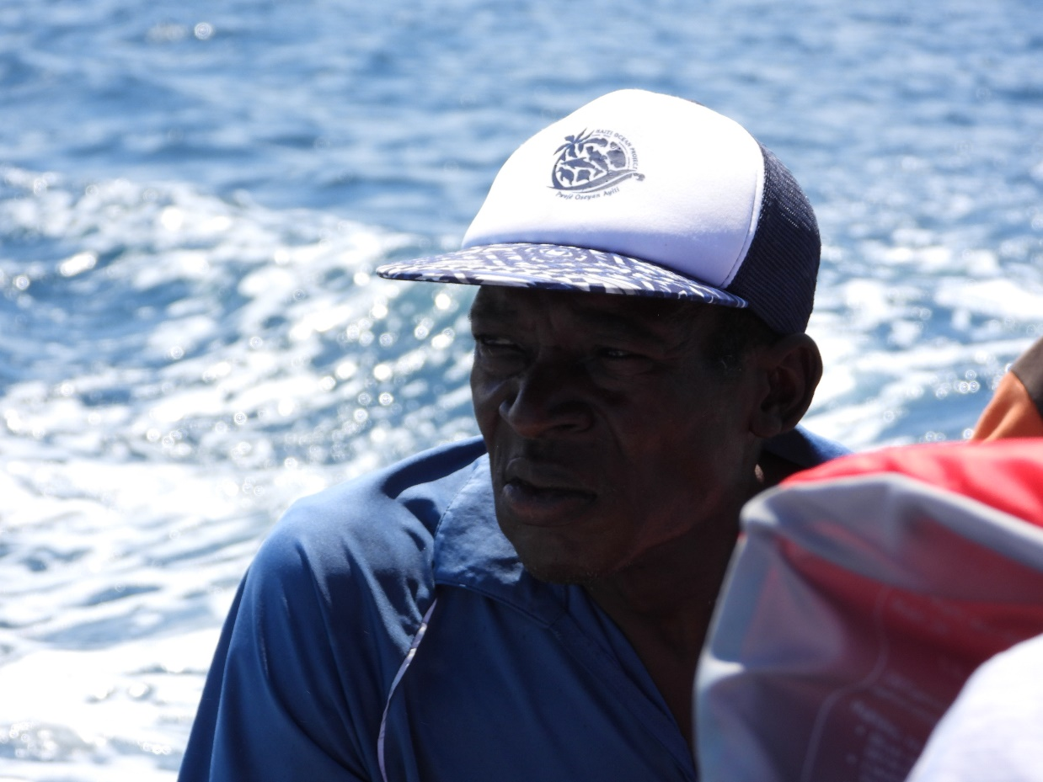
Emmanuel “Manno” Denis
Mr. Manno
Haitian fisher – afraid of sperm whales
Keeps a small pile of rocks in his boat

Slide 11
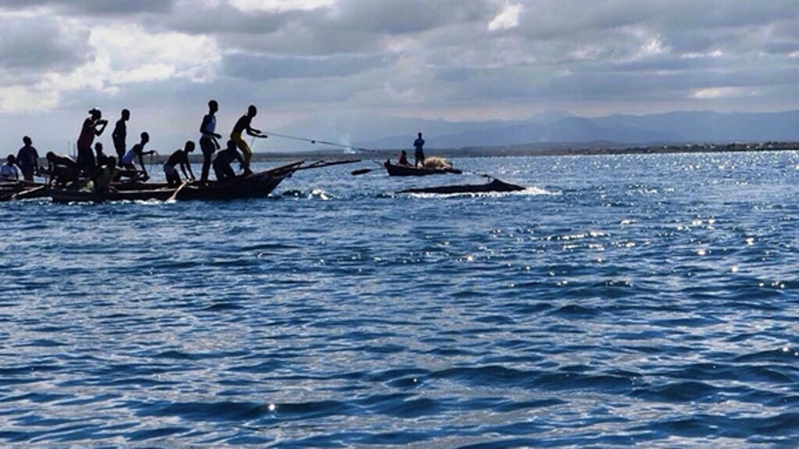
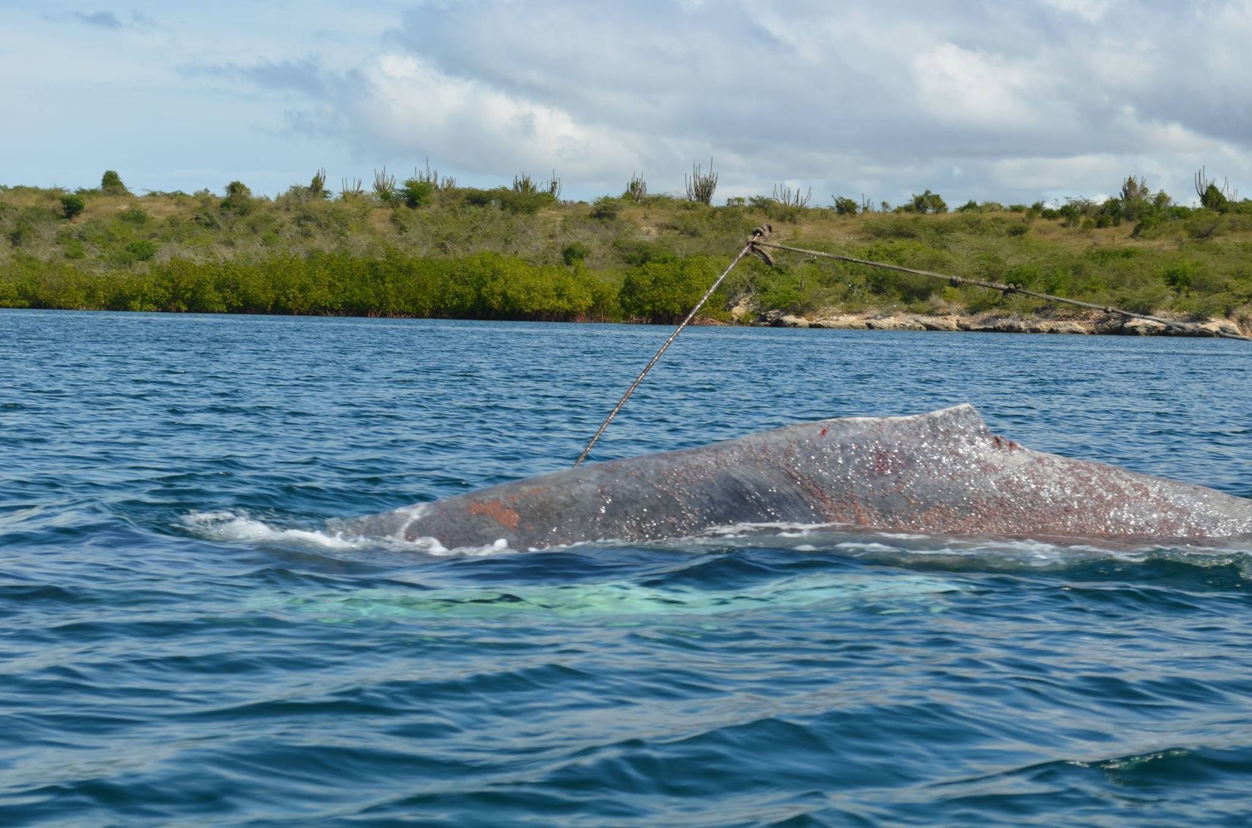
Haiti whale incident #1
Humpback whale harpooned, then stranded and died
January 2015, Fort Liberte

Slide 12
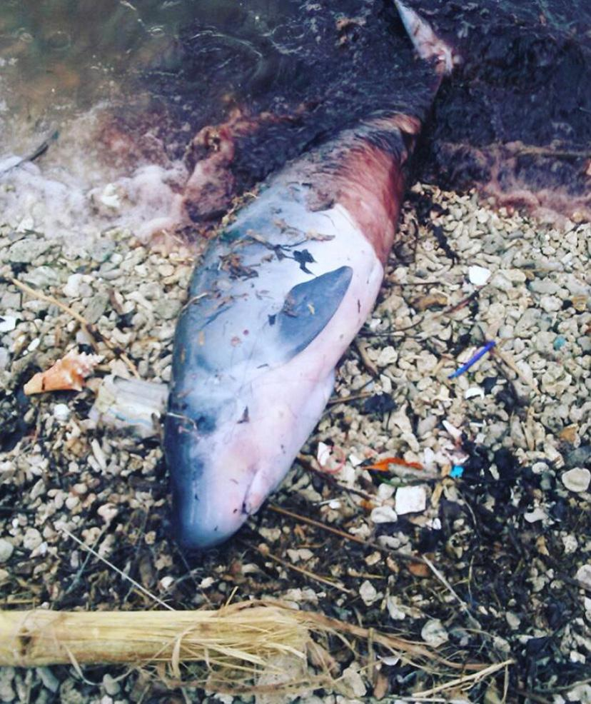
Haiti whale incident #2:
Dwarf sperm whale speared and killed
November 2016
Anse a Veau

Slide 13
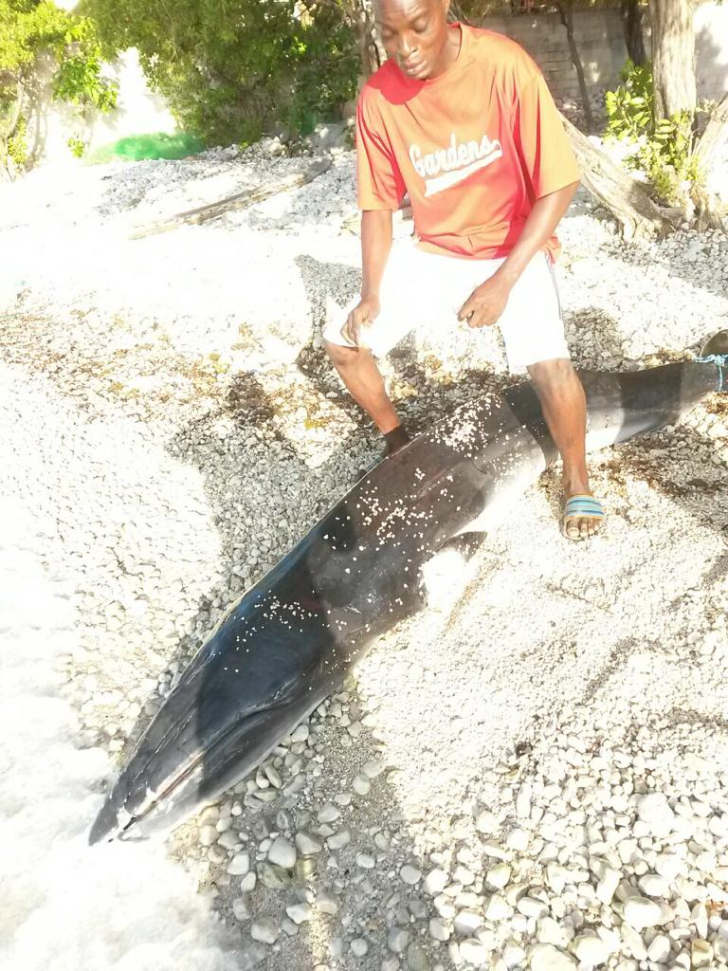
Haiti whale incident #3:
Juvenile minke whale found dead in a gillnet
February 2017
Cotes des Arcadins

Slide 14
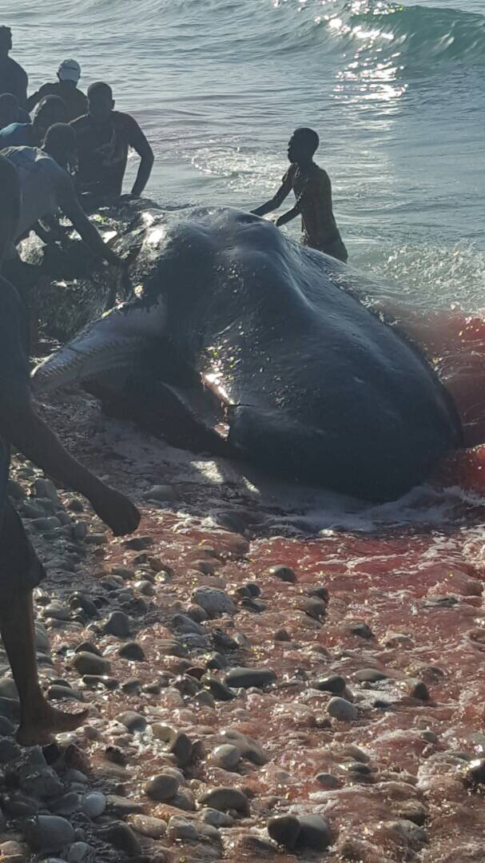
Haiti whale incident #4:
Sperm whale beached and killed
June 2017, Jacmel

Slide 15
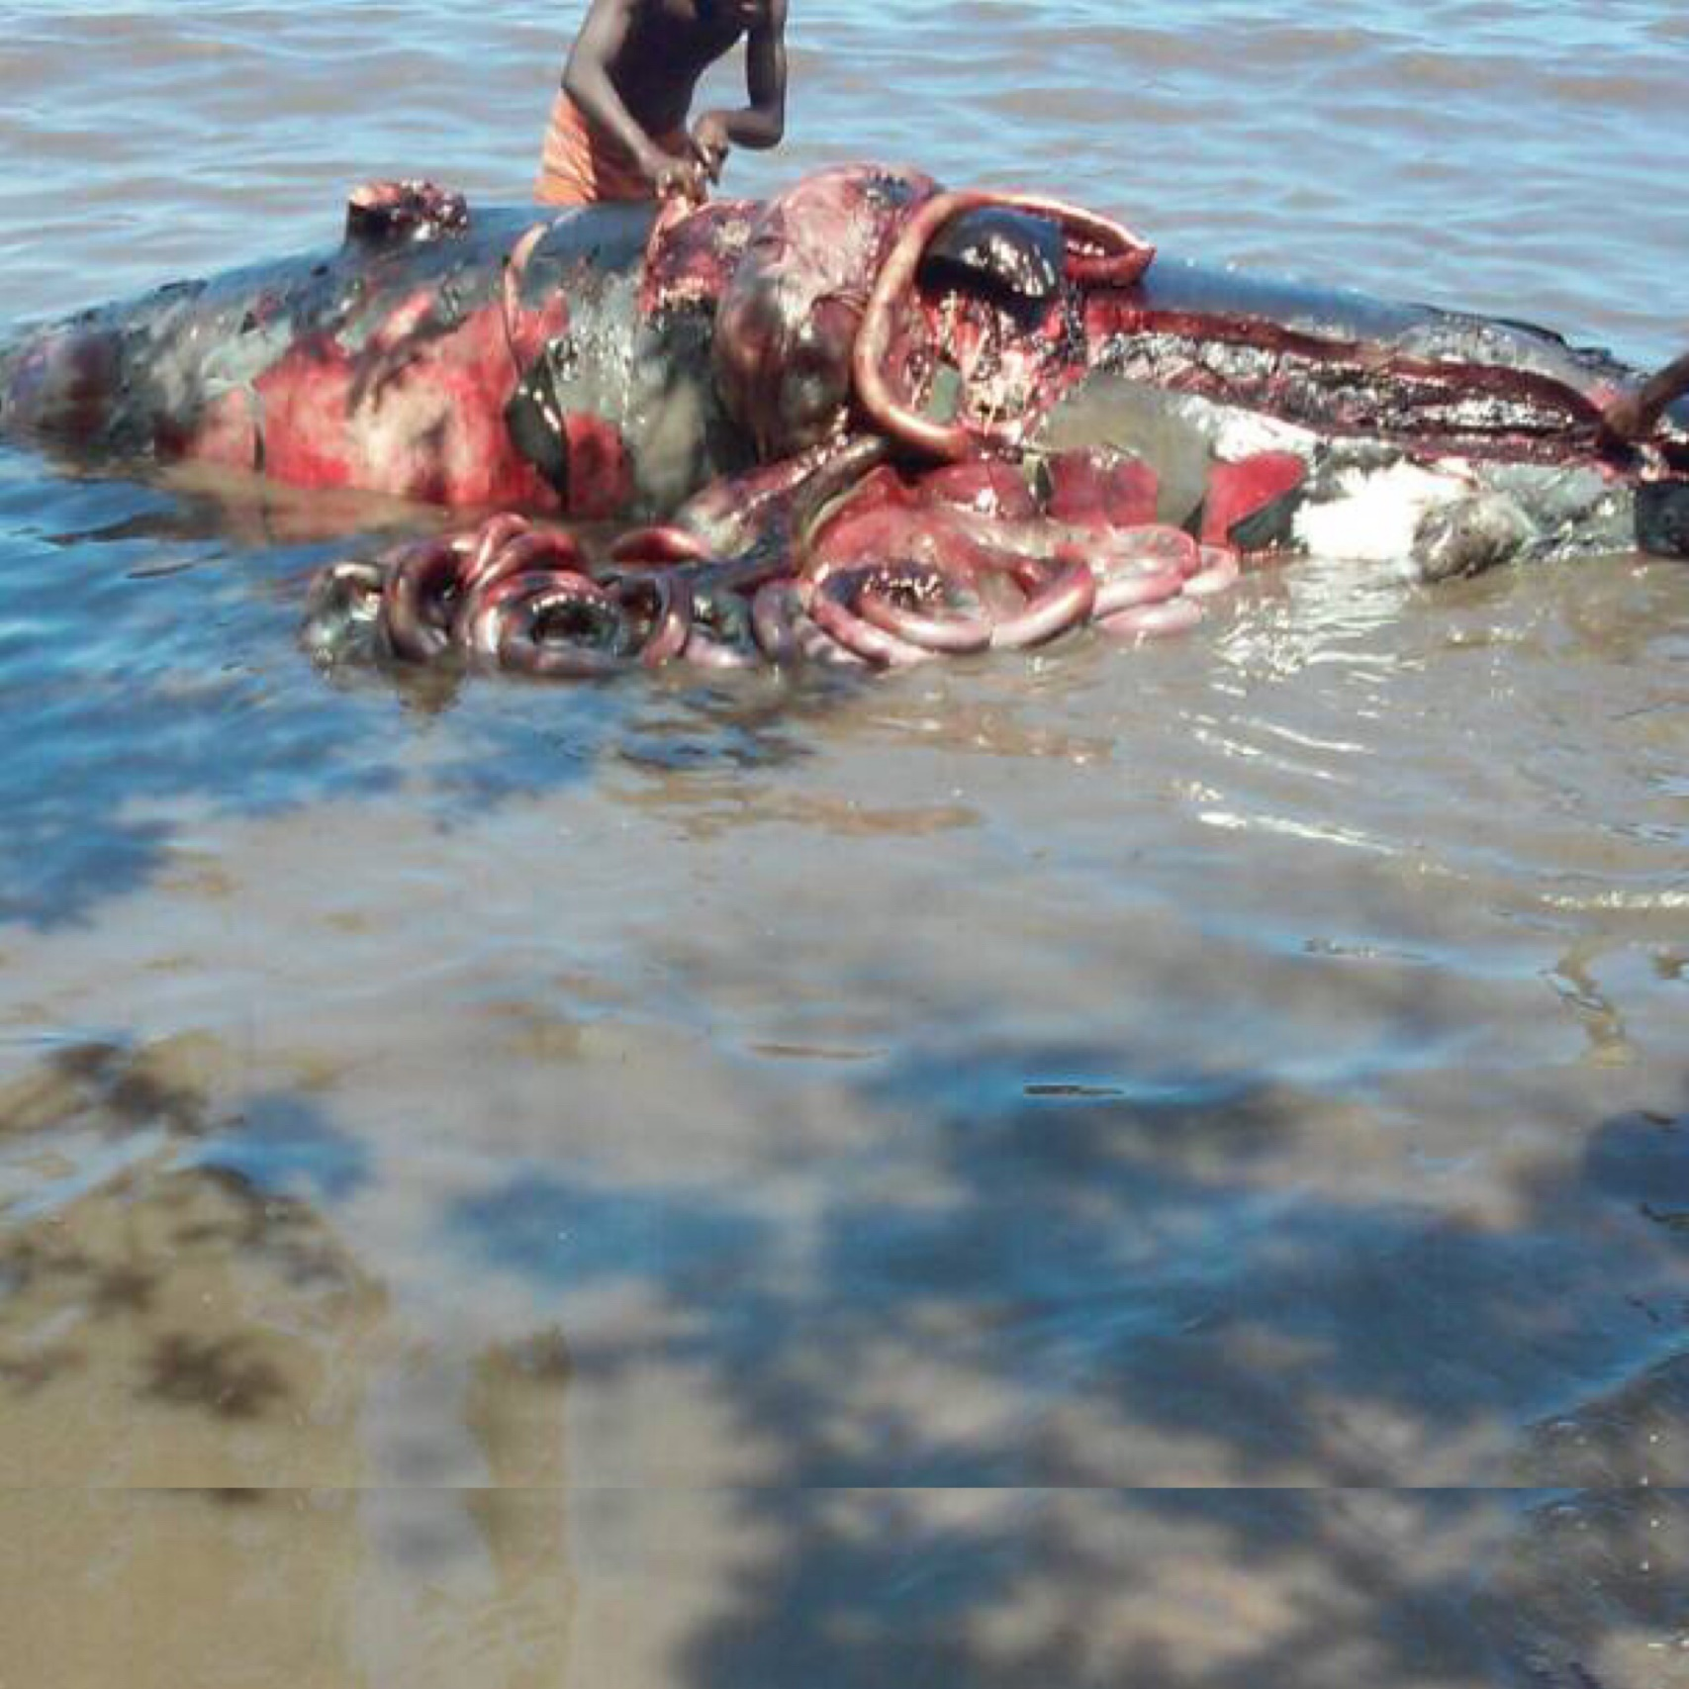
Haiti whale incident #5:
Stranded beaked whale killed
April 2018, Petit Trou de Nippes

Slide 16
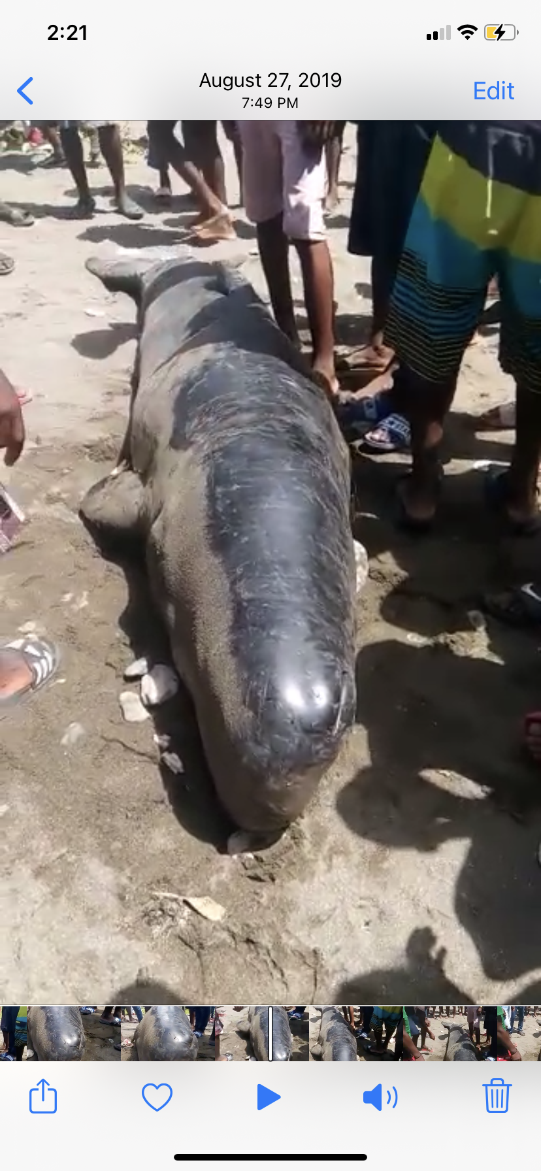
Haiti whale incident #6:
Sperm whale calf brought to shore in net and killed
September 2019, Tiburon

Slide 17
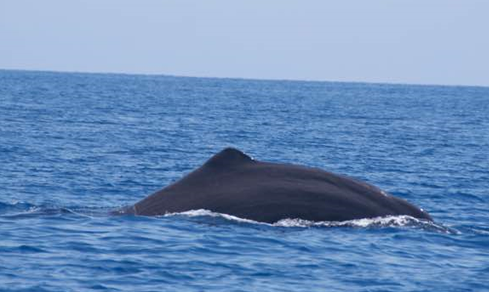
More about our whale populations:
Sperm whale – a.k.a. Soufflé / Largest toothed whale in the world
Observed year-round – over 50 confirmed sightings since 2007

Slide 18
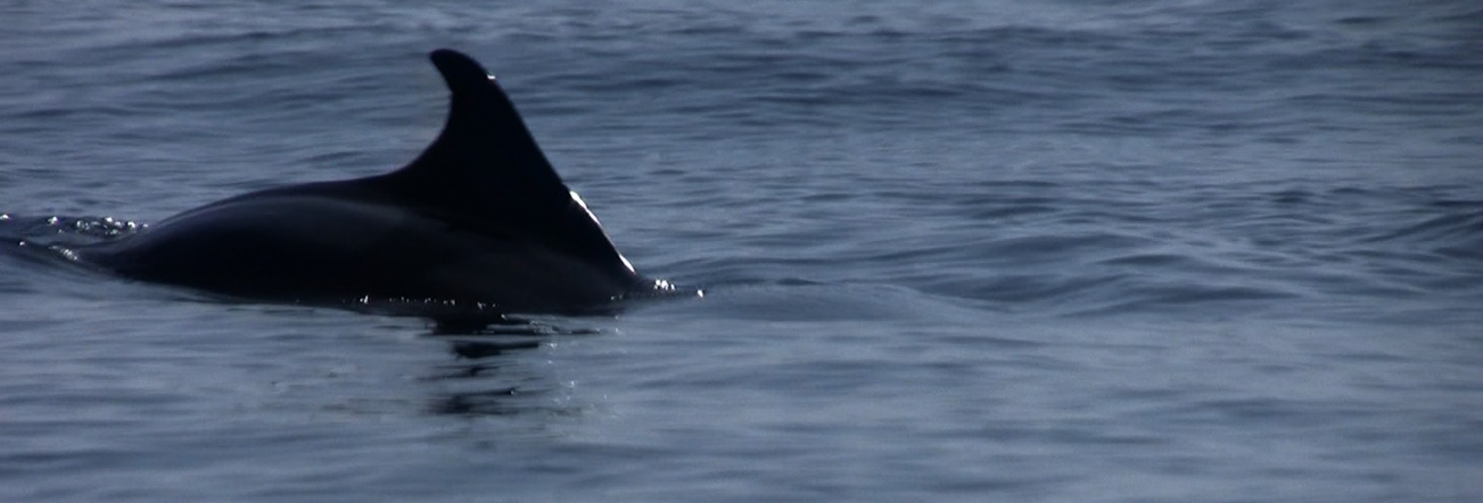
More about our whale populations:
Dwarf sperm whale / The world’s smallest whale species
Over a dozen documented sightings along inner southern coastline

Slide 19
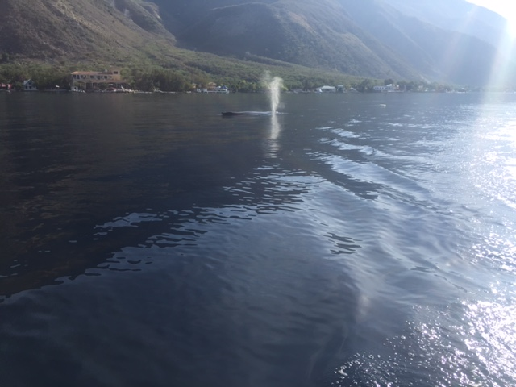
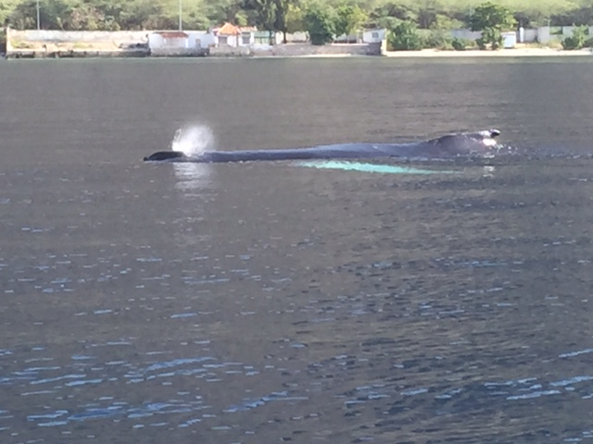
More about our whale populations:
Humpback whale
Only 3 confirmed sightings to our knowledge

Slide 20
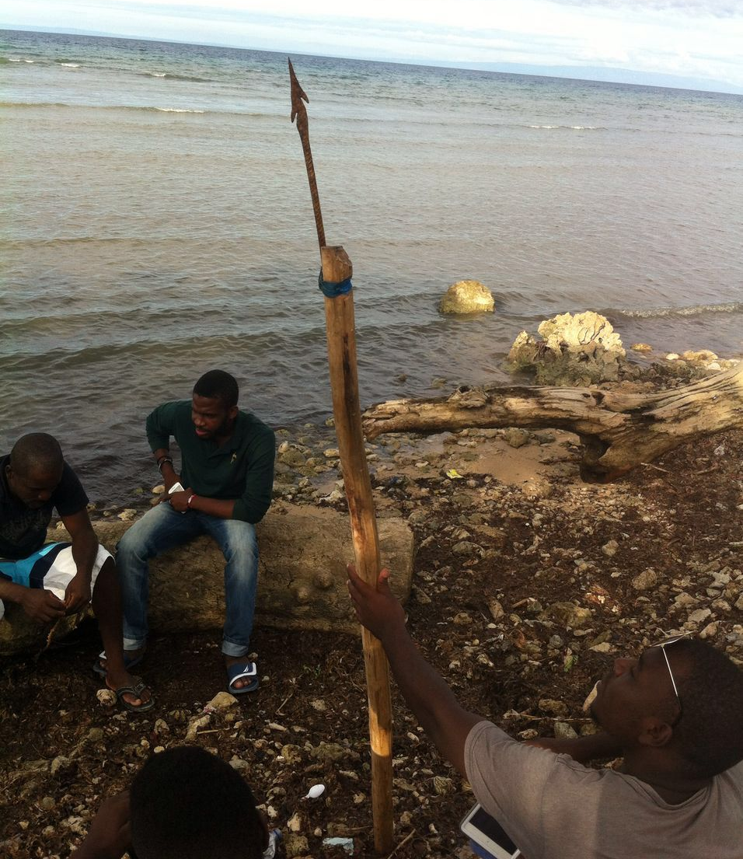
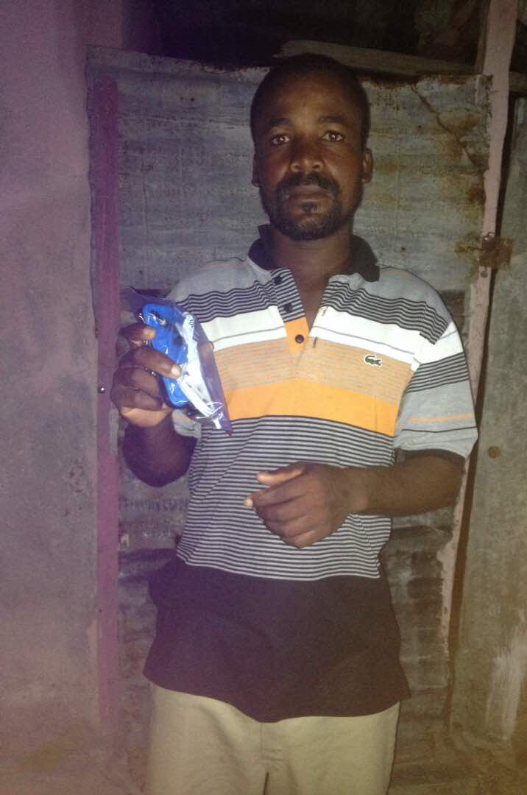
How can we involve local Haitians in whale conservation?
1. Educating fishers
a. Motivate fishers to join HOP

Slide 21
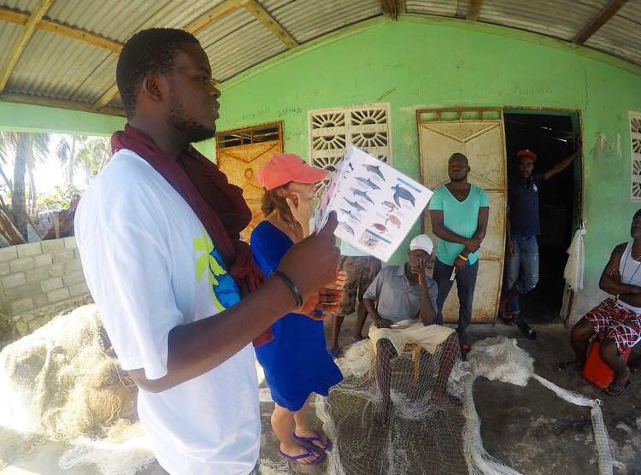
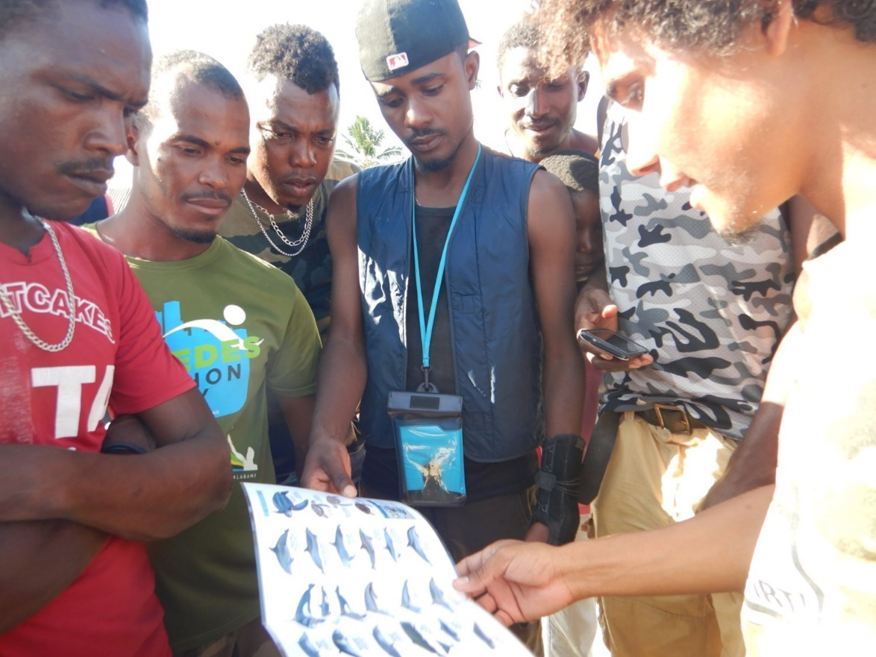
b. Share Haiti marine species guide

Slide 22
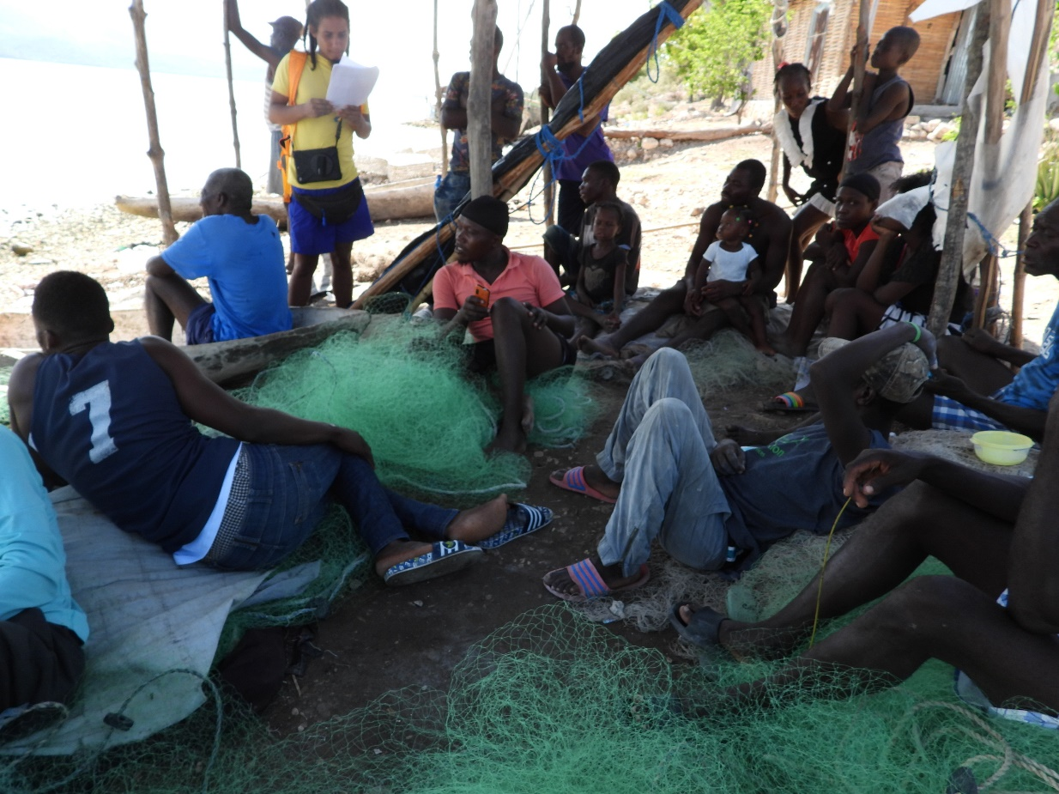
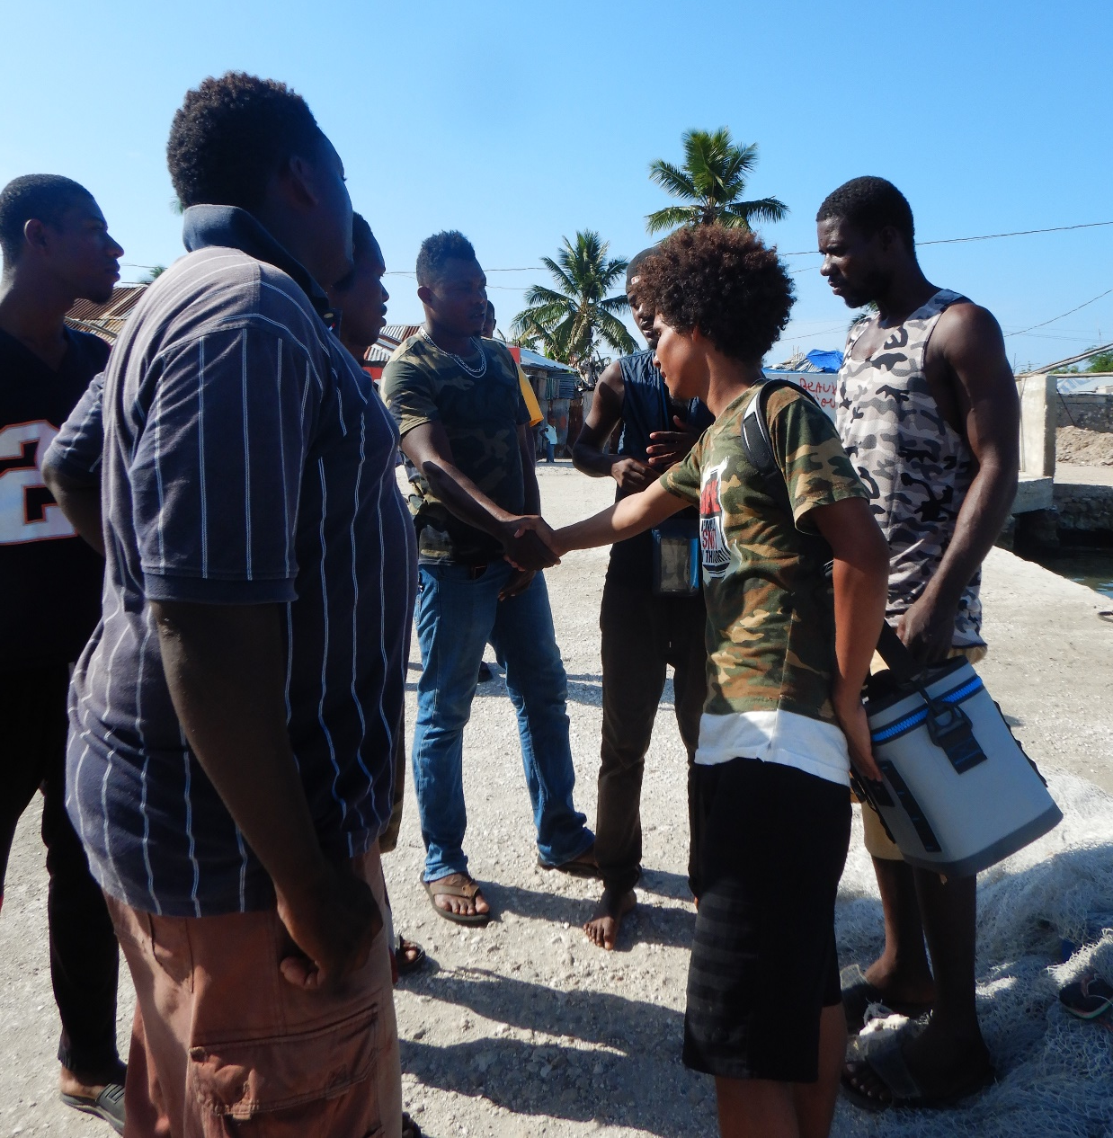
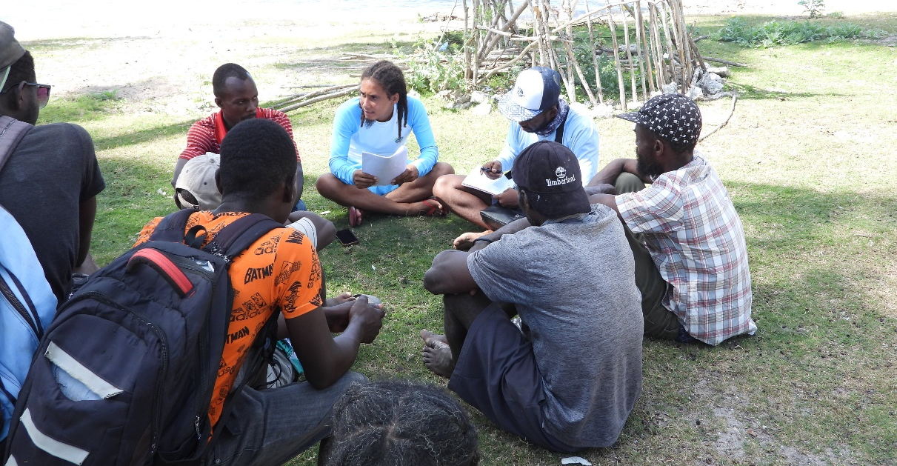
c. Build partnerships

Slide 23
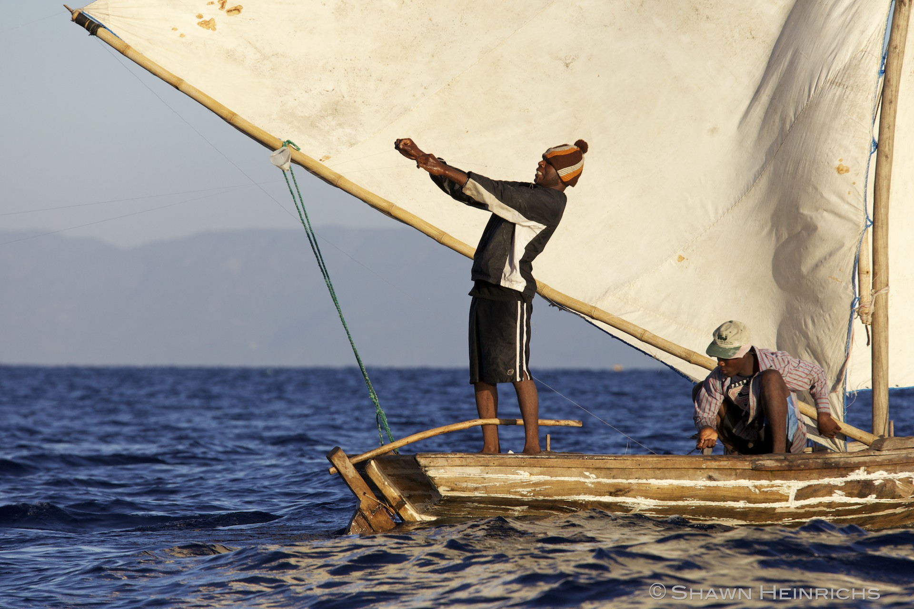
4. Fisher monitoring network – “Have you seen the whales today?”

Slide 24
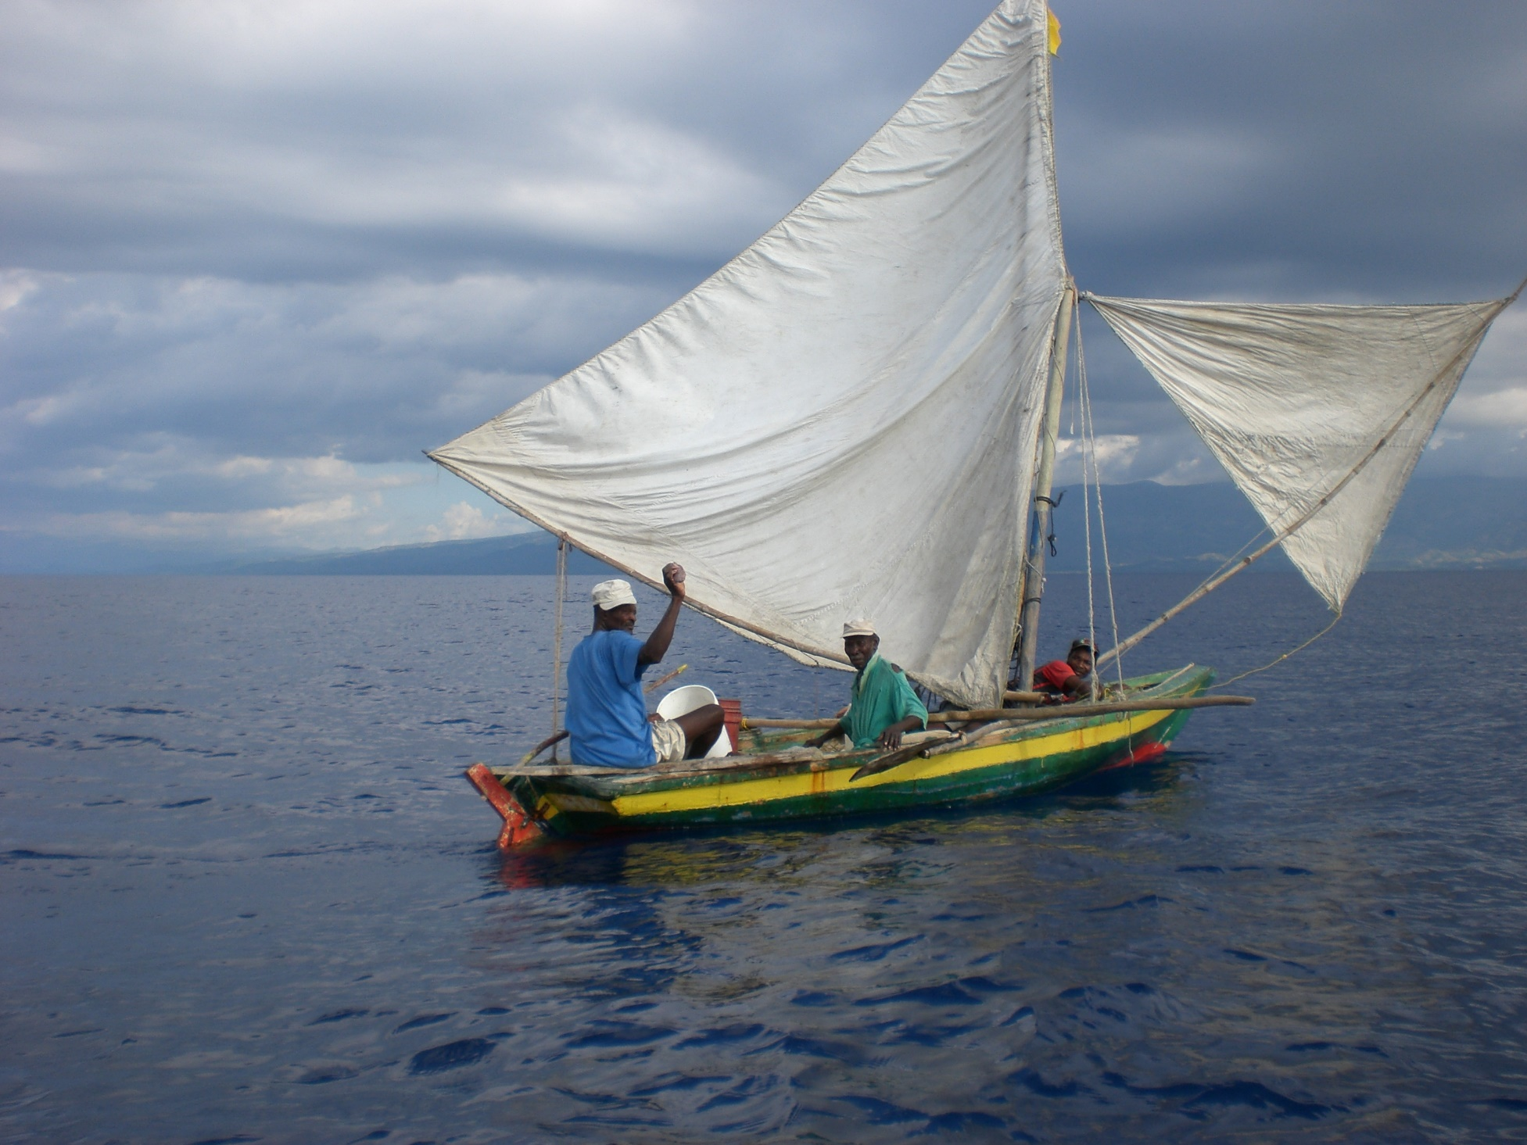
“Call us if you see a whale today!

Slide 25
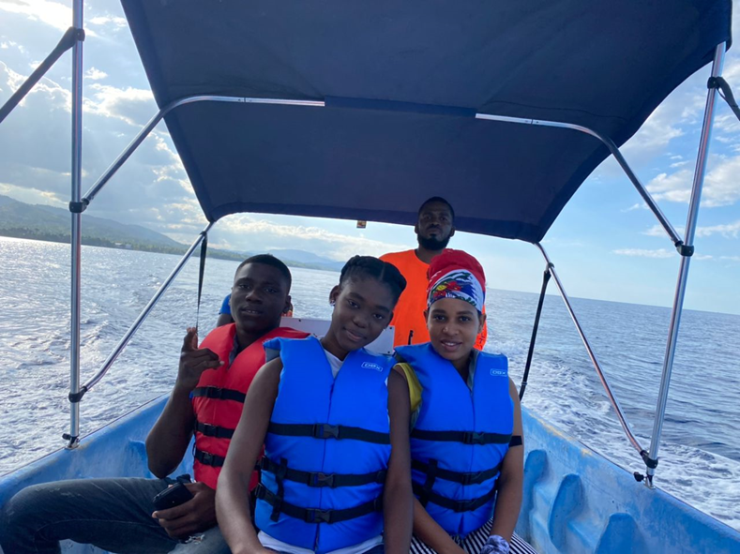
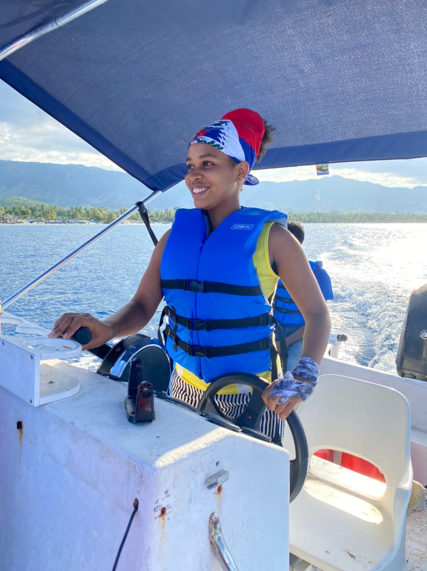
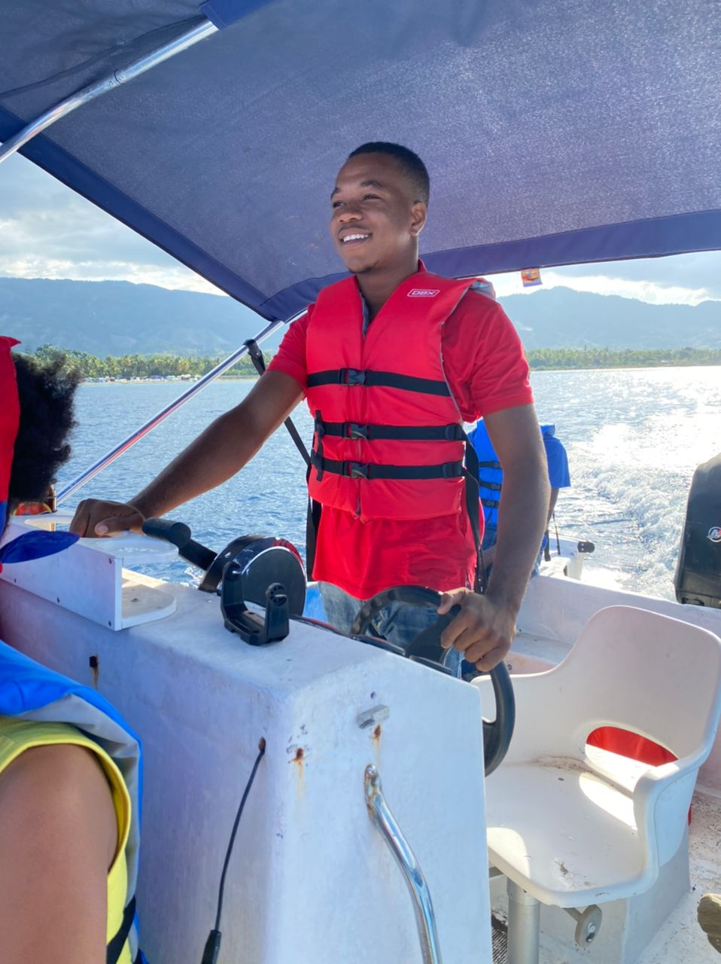
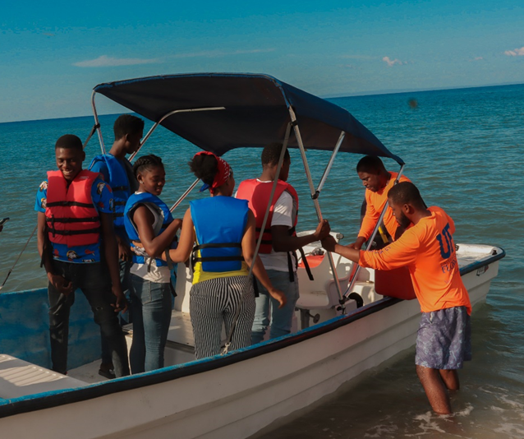
Youth education
Inspiring Haiti’s next generation
To protect their marine environment

Slide 26
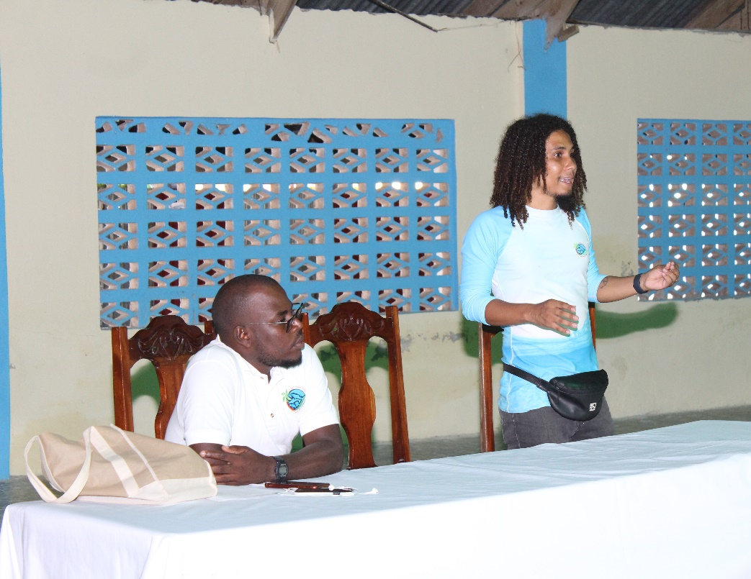
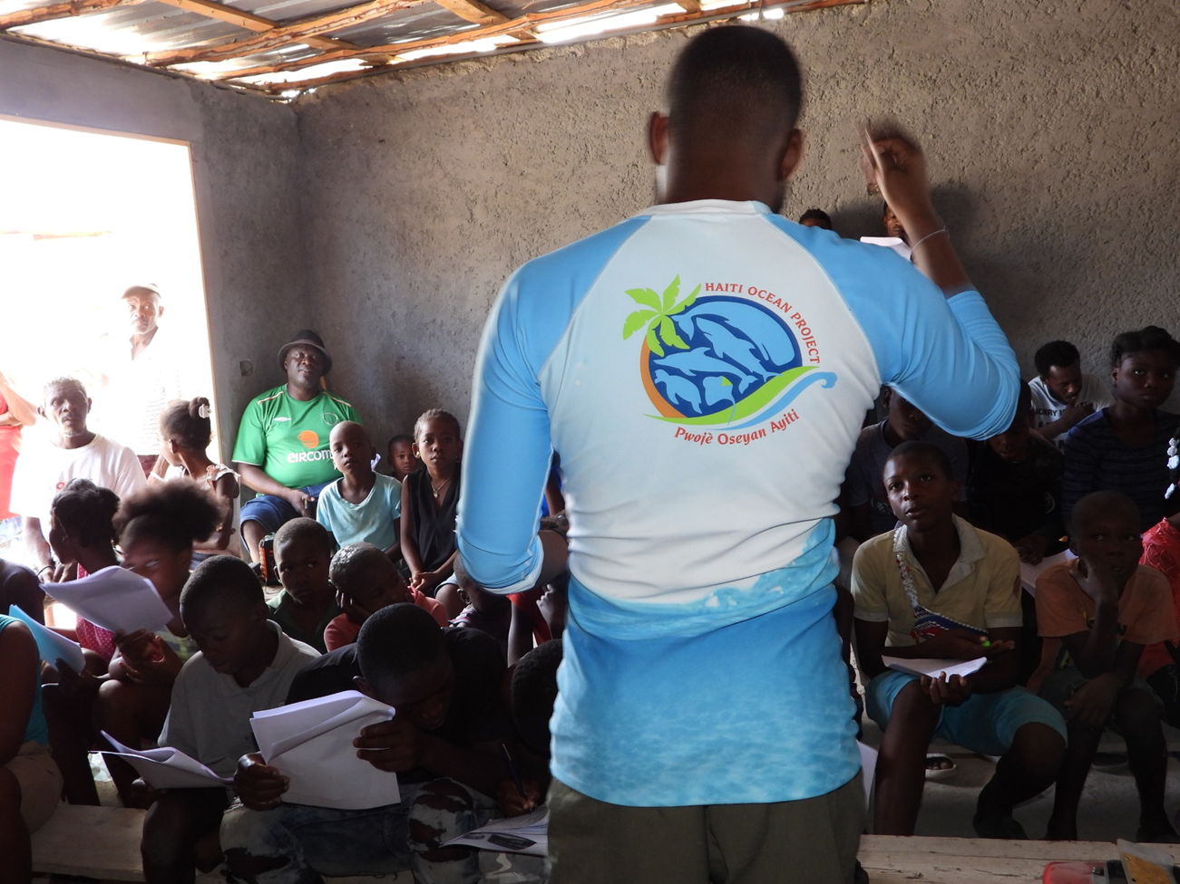
Community workshops

Slide 27
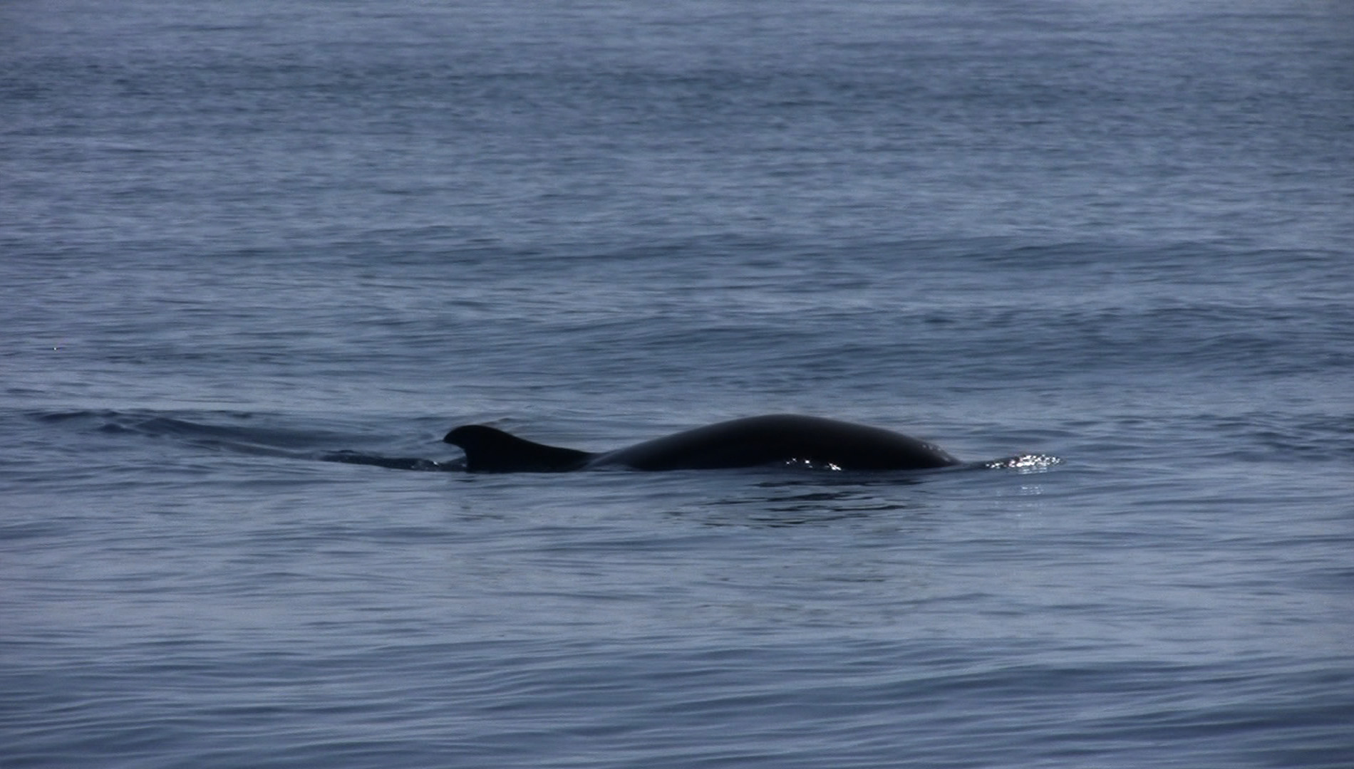
Future goals: Assessments of whale populations

Slide 28
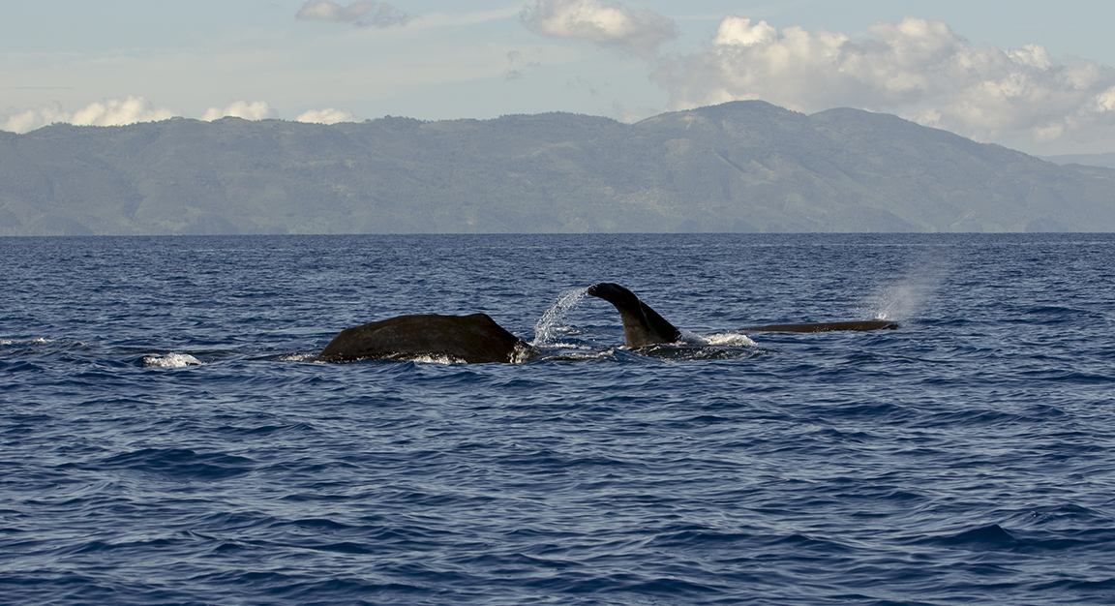
Future goals: Community-based whale watching

Slide 29
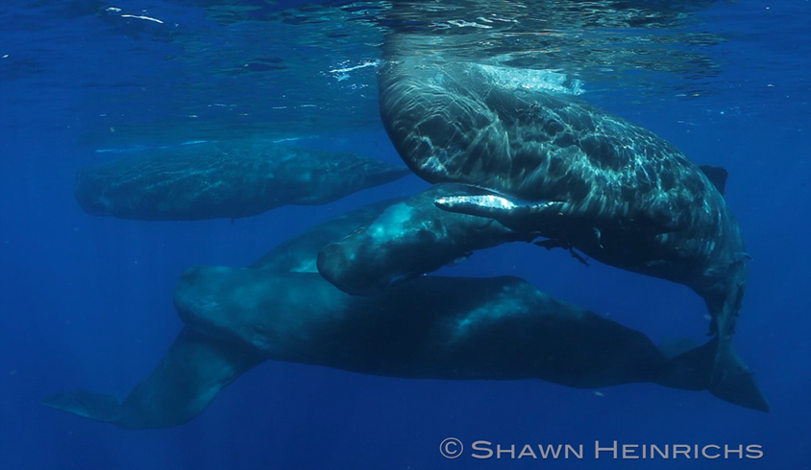
Future goals: Marine mammal sanctuary

Slide 30
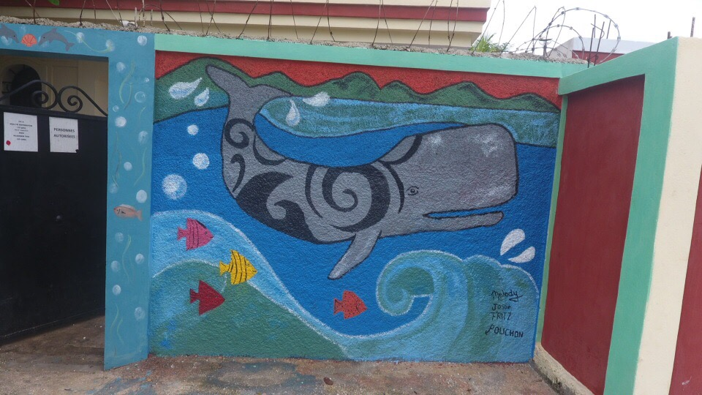
Any questions?
Haiti Ocean Project
website: www.haitioceanproject.org
Instagram: Instagram.com/haitioceanproject
Email: jamieaquino@yahoo.com
Cell: (954) 439-6458

